Slide 1


Neural Image Captioning
Sezai Burak Kantarcı • 03.06.2020

Slide 2
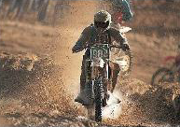
Problem Statement
Computer Vision and Natural Language Processing.
A description must capture not only the objects contained in an image, but it also must express how these objects relate to each other as well as their attributes and the activities they are involved in.
A person riding a motorcycle on a dirt road.

Slide 3
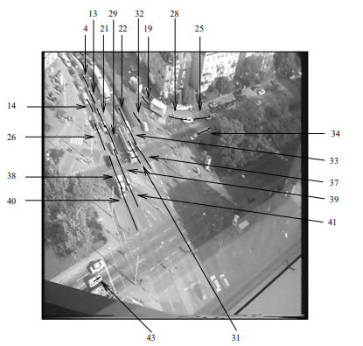
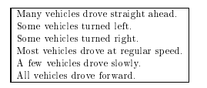
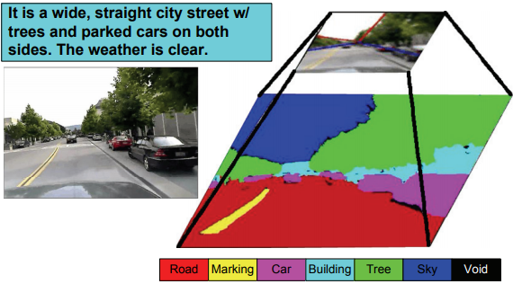
Related Work
Knowledge representation for the generation of quantified natural language descriptions of vehicle traffic in image sequences. (Heilbronn University, 1996)
Image parsing to text description. (University of California, 2010)

Slide 4
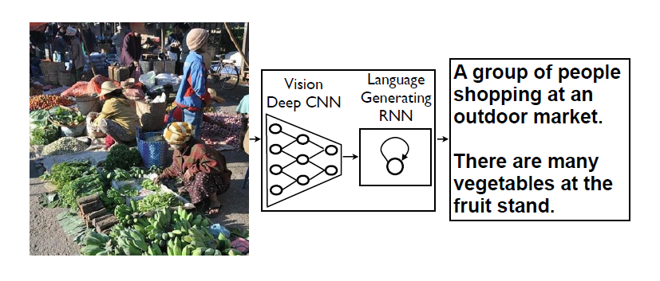
Show and Tell (Google, 2015)
NIC, our model, is based end-to-end on a neural network consisting of a vision CNN followed by a language generating RNN.
A single joint model that takes an image I as input, and is trained to maximize the likelihood p(S|I) of producing a target sequence of words S = {S1, S2, …} where each word St comes from a given dictionary, that describes the image adequately.

Slide 5
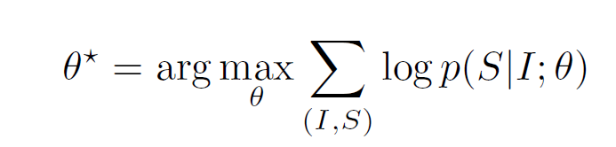
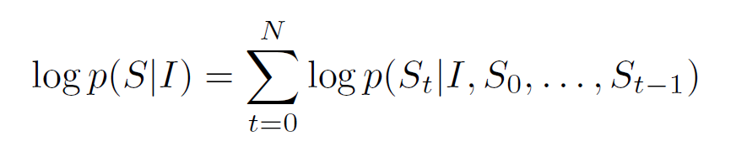
CNN + RNN
Combining deep convolutional nets for image classification with recurrent networks for sequence modeling, to create a single network that generates descriptions of images.
Maximize the probability of the correct description given the image.
At training time, (S; I) is a training example pair, and we optimize the sum of the log probabilities over the whole training set using Stochastic Gradient Descent.
θ – Parameters of the Model
I – Image
S – Correct Transcription
N – Length of the Sentence

Slide 6
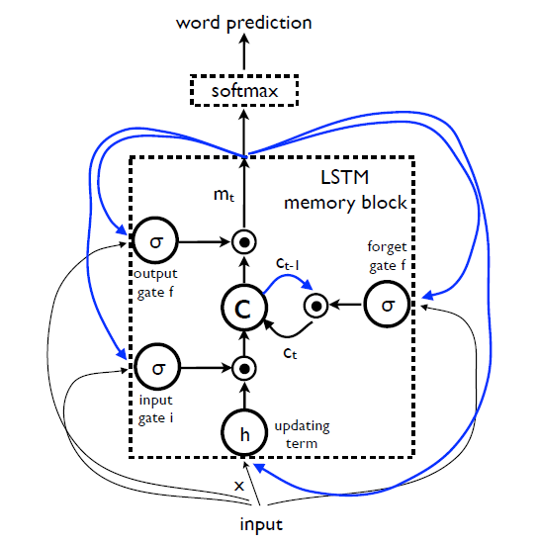
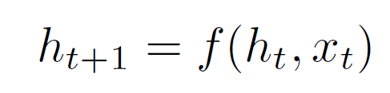
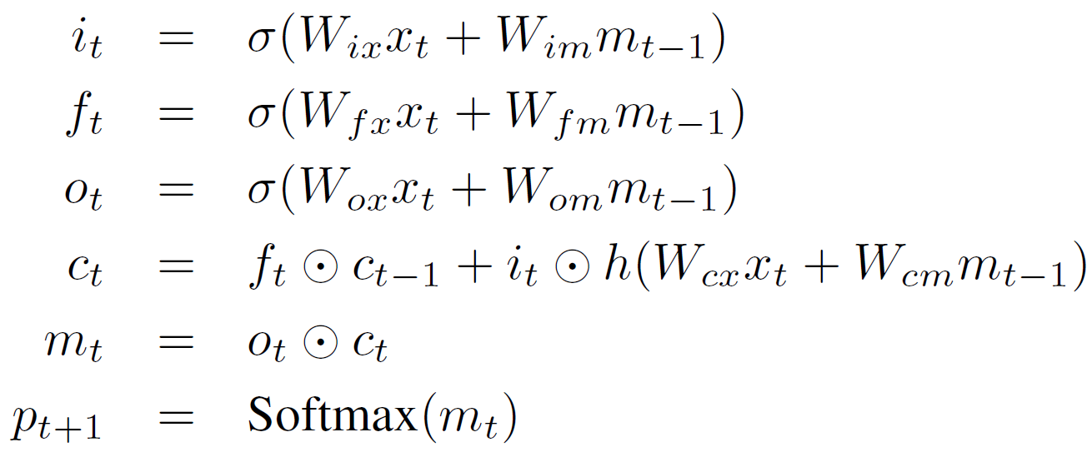
LSTM Based Sentence Generator
p (St|I , S0, … , St-1) is modeled by an RNN, where the variable number of words we condition upon up to t - 1 is expressed by a fixed length hidden state or memory ht.
xt – New Input
f is a Long Short Term Memory Net (LSTM).

Slide 7
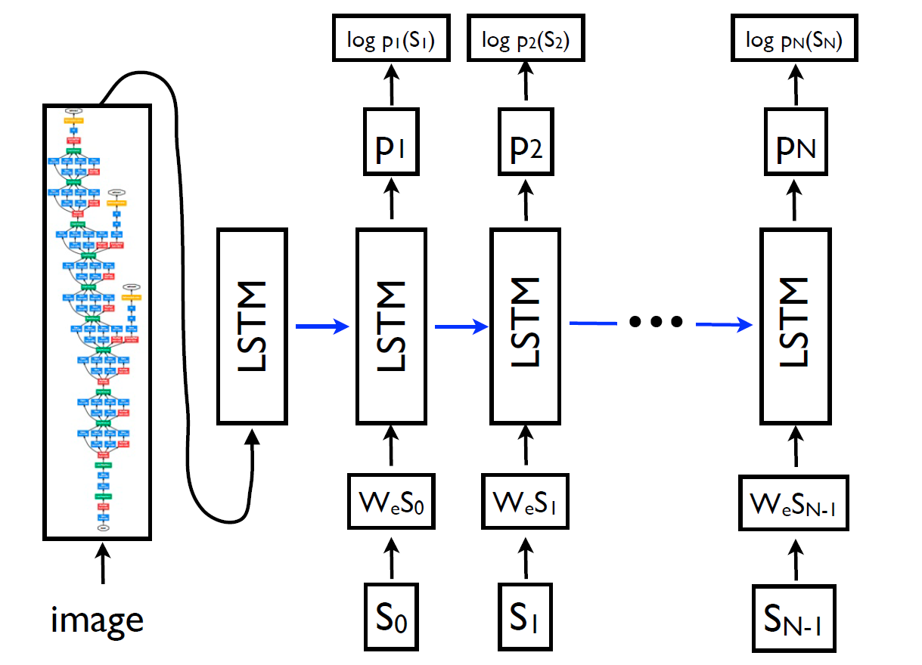
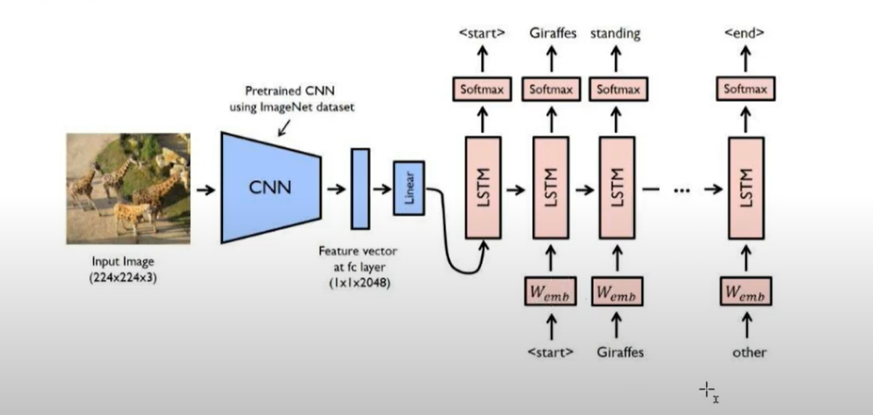
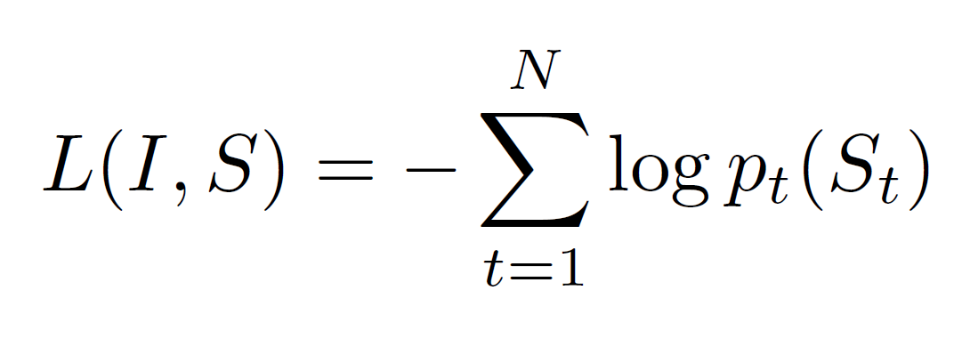
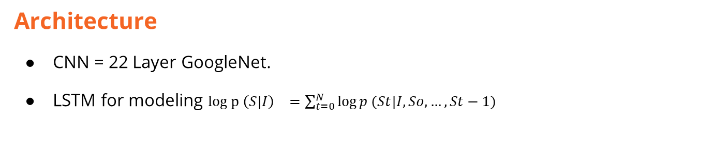
Architecture
CNN = 22 Layer GoogleNet.
LSTM for modeling $log p {\left(S|I\right)}^{}=\sum_{t=0}^{N}{\log{p (St|I, So, …, St−1)}}$
The loss is the sum of negative log likehood of the correct Word at each step as

Slide 8
Results of Show and Tell
BLEU (5 different captions by people; 2002), a metric on Flickr-8k, MSCOCO and Pascal datasets .

Slide 9
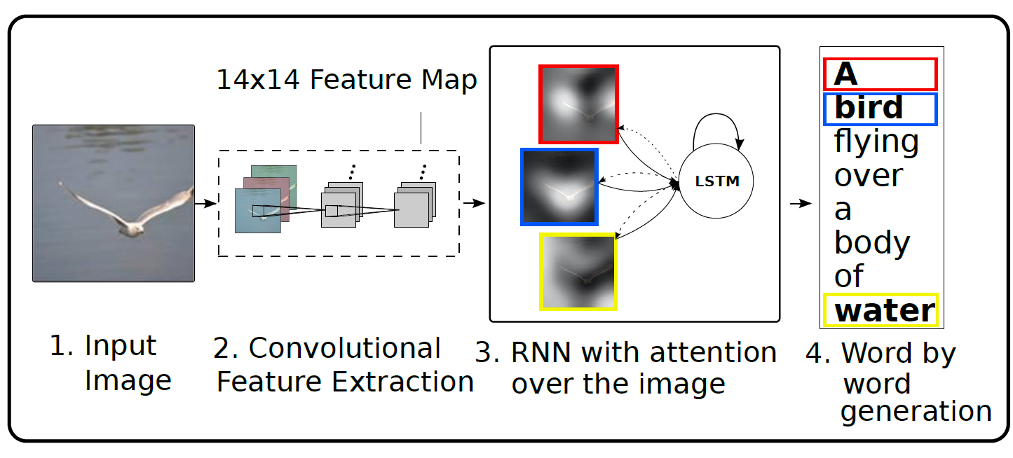
Show and Attend And Tell (University of Montreal, 2016)
Incorporating attention for caption generation.
Rather than compress an entire image into a static representation, attention allows for salient features to dynamically come to the forefront as needed. This is especially important when there is a lot of clutter in an image.

Slide 10
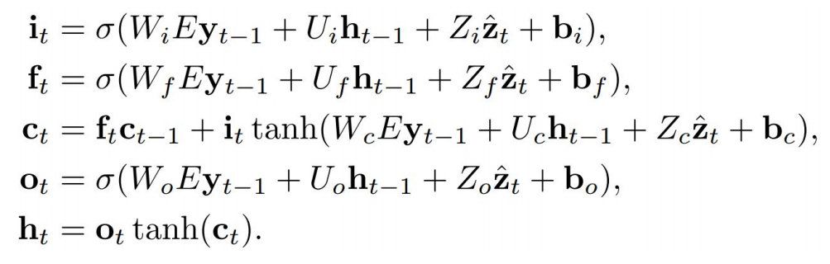
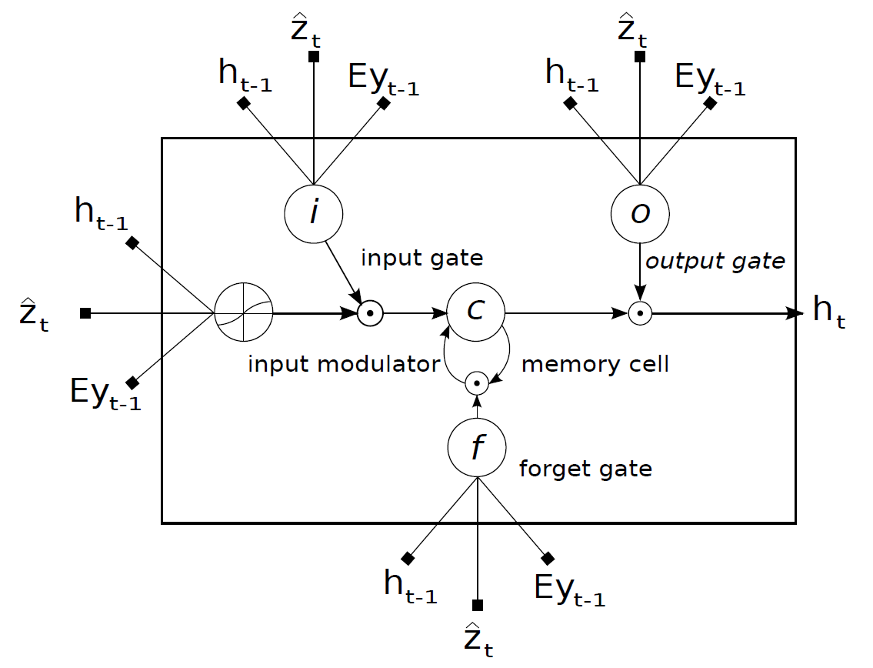
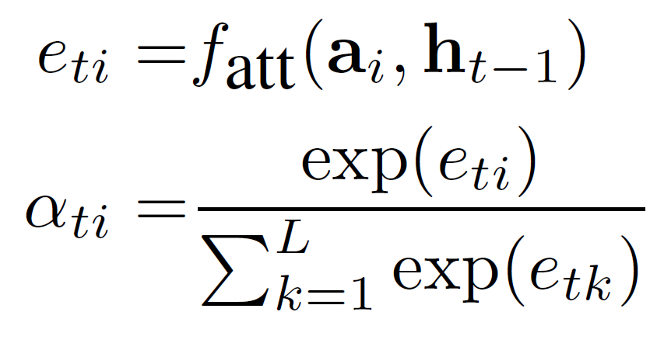
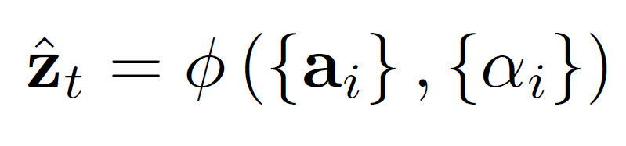
LSTM Network
Zt = Context vector.
İ,f,c,o: Input, forget, memory, output and hidden state gates.
W, U, Z: weight matrices
b: biases
E: an embedding matrix
Zt : representation of the relevant part of the image at time t
A LSTM cell, lines with bolded squares imply projections
with a learnt weight vector.

Slide 11
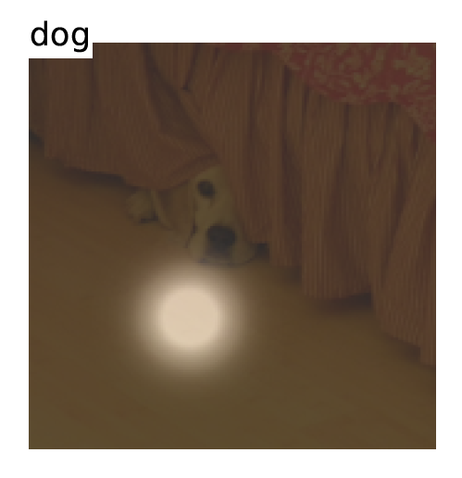
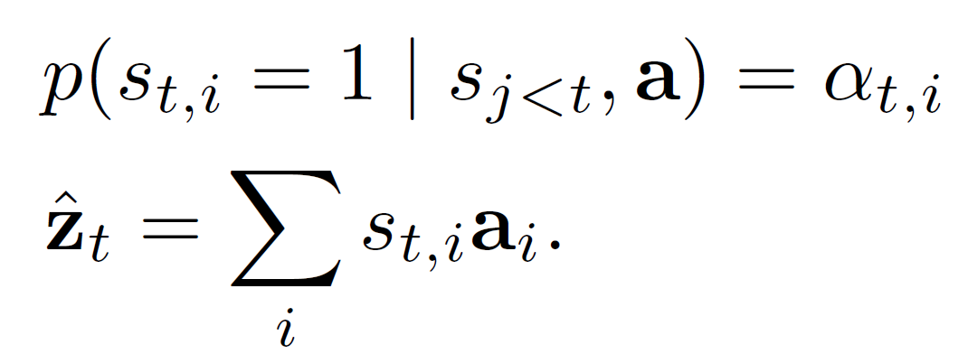
Hard Attention
Stochastic attention: the probability that location i is the correct place to focus on for producing the next word (Assigning a Multinoulli Distrubition).
Learning to maximize the context vector z from a combination of a one-hot encoded variable St,i and the extracted features ai.
Trained using sampling method.
st - where the model decides to focus attention when generating the tth Word.

Slide 12
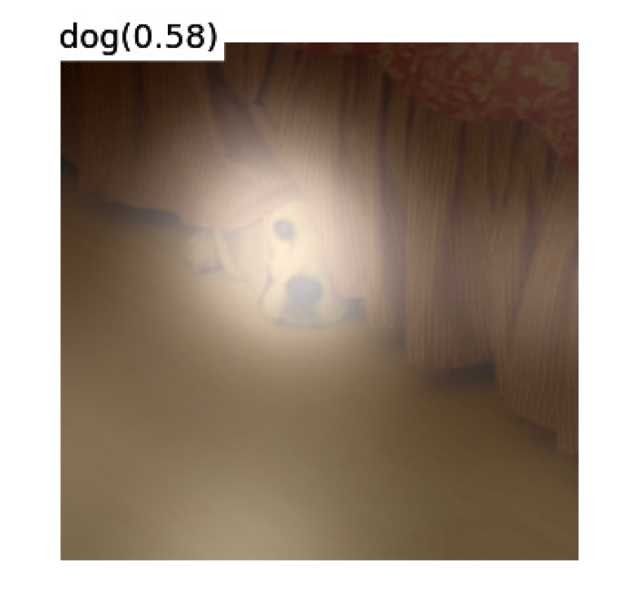
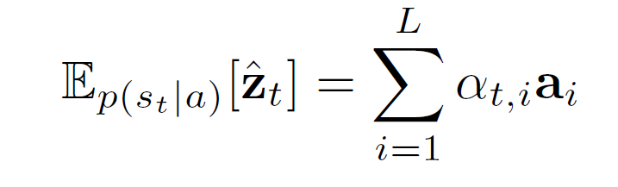
Soft Attention
Deterministic attention: the relative importance to give to location i in blending the ai ’s together { Whole distribution optimized, not single choices ( st not picked from a distribution) }.
Trained end to end.

Slide 13
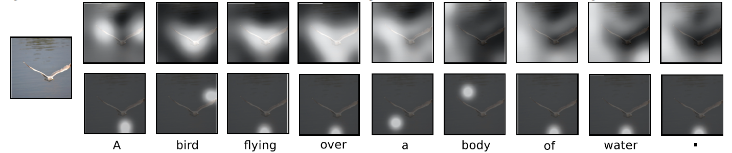
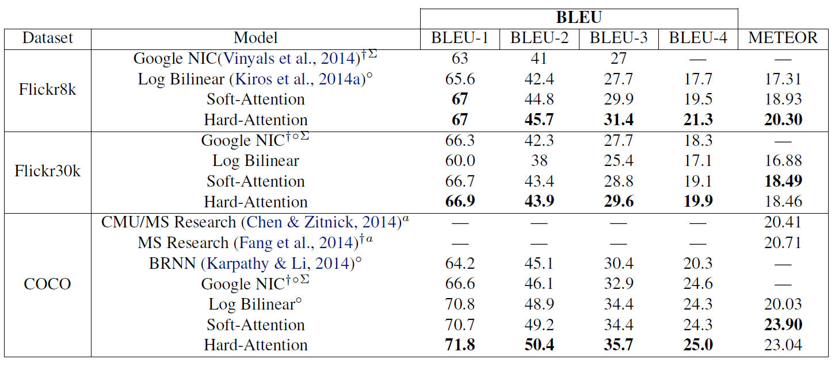
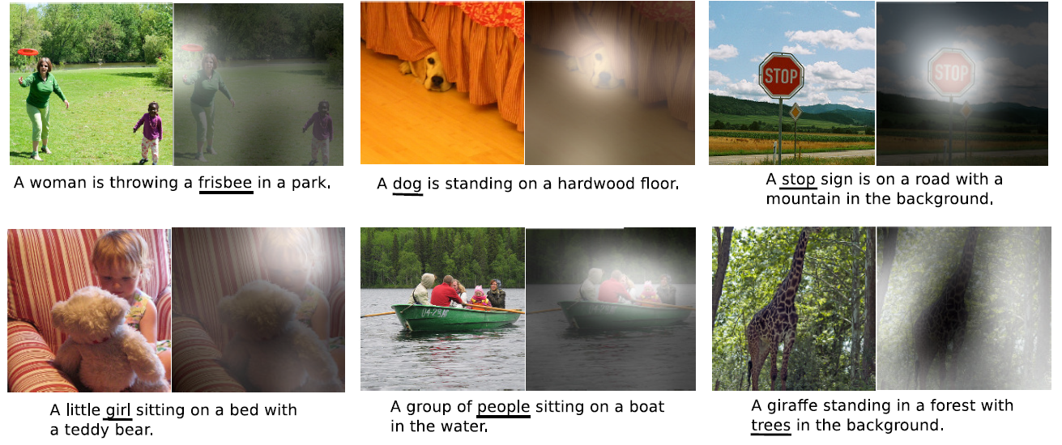
Results of Show, Attend and Tell
Comparison with NIC and Log Bilenear.
Attention over time. Soft – top row; Hard – bottom row.
Examples of Attending the correct object.

Slide 14
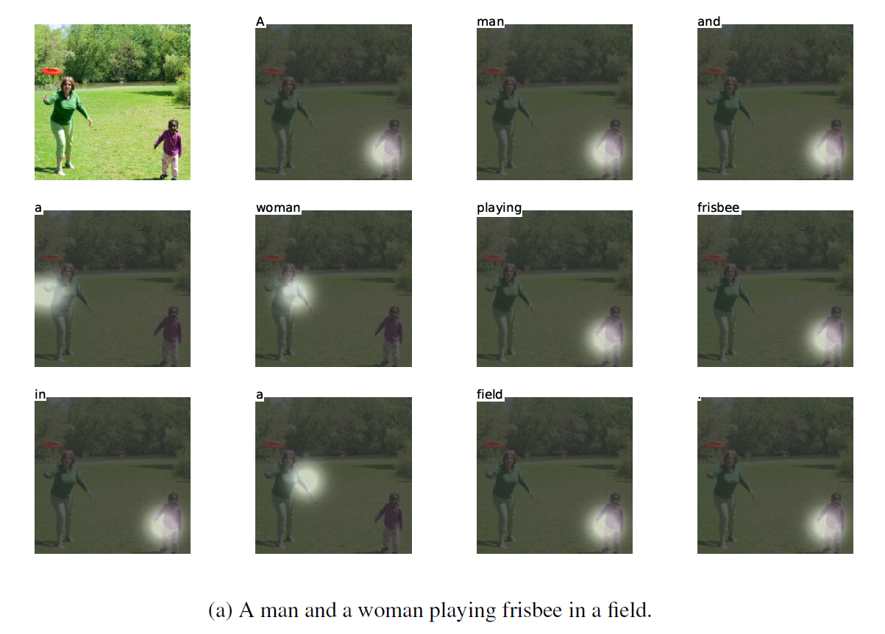
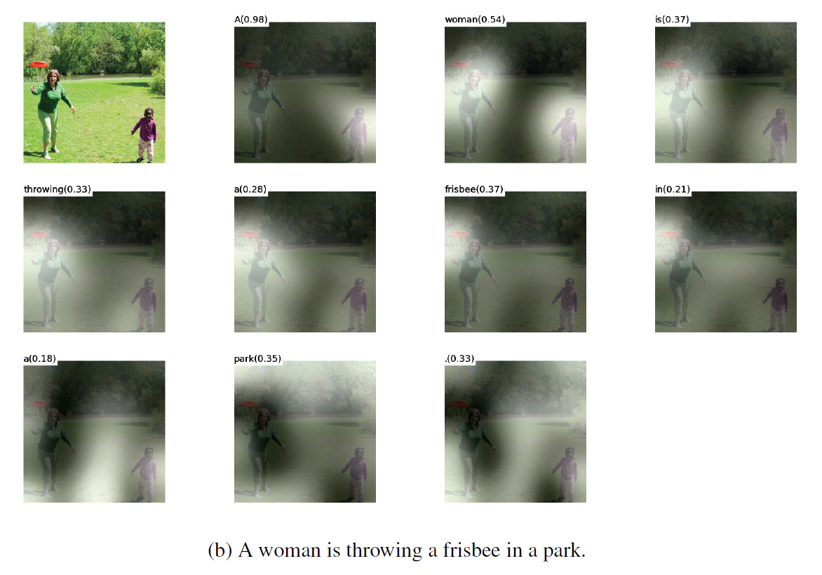
Visualizations from ‘Hard’ (a) and ‘Soft’ (b) Attention Model

Slide 15
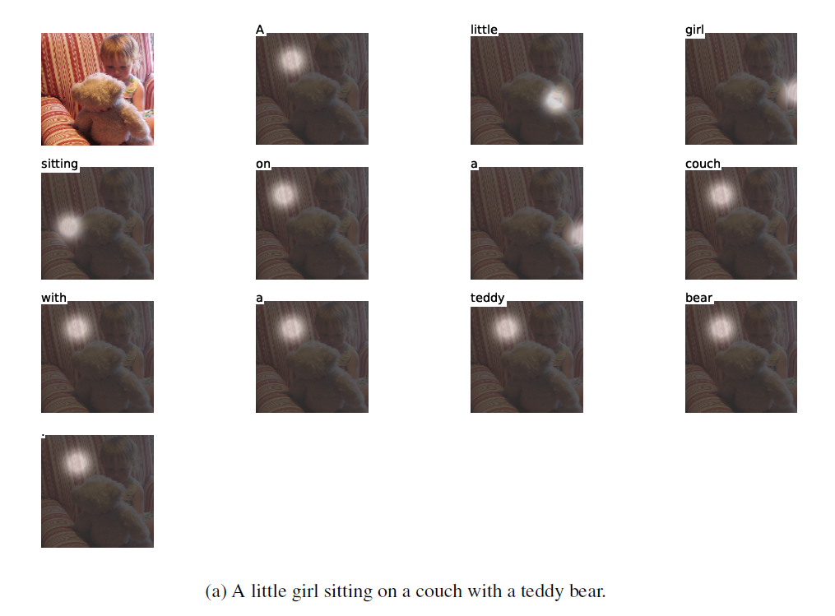
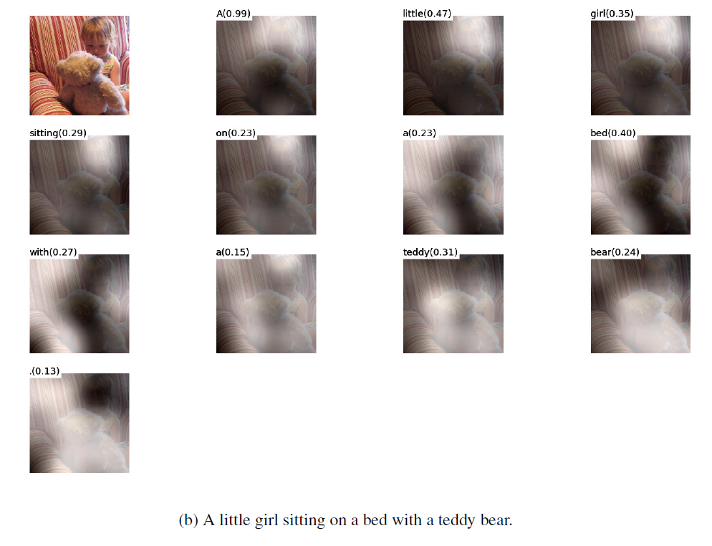
Visualizations from ‘Hard’ (a) and ‘Soft’ (b) Attention Model

Slide 16
References
R. Gerber and H.-H. Nagel. Knowledge representation for the generation of quantified natural language descriptions of vehicle traffic in image sequences. In ICIP. IEEE, 1996.
B. Z. Yao, X. Yang, L. Lin, M. W. Lee, and S.-C. Zhu. I2t: Image parsing to text description. Proceedings of the IEEE, 98(8), 2010.a
Hochreiter, S. and Schmidhuber, J. Long short-term memory. Neural Computation, 9(8):1735–1780, 1997.
Vinyals, Oriol, Toshev, Alexander, Bengio, Samy, and Erhan, Dumitru. Show and tell: A neural image caption generator. arXiv:1411.4555, November 2014.
Ba, Jimmy Lei, Mnih, Volodymyr, and Kavukcuoglu, Koray. Multiple object recognition with visual attention. arXiv:1412.7755, December 2014
Xu, Kelvin & Ba, Jimmy & Kiros, Ryan & Cho, Kyunghyun & Courville, Aaron & Salakhutdinov, Ruslan & Zemel, Richard & Bengio, Y. Show, Attend and Tell: Neural Image Caption Generation with Visual Attention. arXiv:1502.03044, 2015

